Slide 1

Recommender System Basics
Presented By:
Dibyam Kumar Agrawal
Research Guide:
Bidyut Kumar Patra
Special Thanks to
IDAL Team

Slide 2
Why?
Enhance user experience
Helps to understand the customers better
Increase sale
Saves time

Slide 3
Recommender System
Raw
Data
Processed
Data
Model
Results
Input data
Training
Evaluation
Rating matrix
Item details
User demographic info
Content Based Filtering
Collaborative Filtering
Demographic Filtering
Hybrid Filtering
Prediction Evaluation
Evaluation of set of Rec. Items
Evaluation of ranked Rec. Items

Slide 4
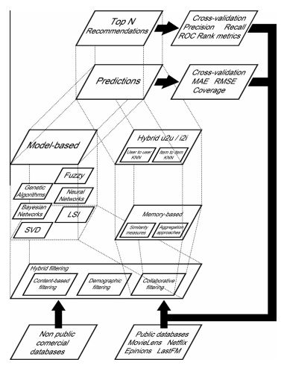

Slide 5
Content Based Filtering (CBF)
Recommends Items with similar content to the items the user has liked in the past.
Only item details are used to find similarity between items, by using various Info retrieval and machine learning techniques.
Example-
Movie Recommendation-
Recommend movies with similar actors, detectors, genre, etc.
Website, blog, news-
Recommend those sites with similar content
Pros-
New items can be recommended by analysing there content.
Community not required.
Cons-
Over Specification
Cold start for new users
Limited Content Analysis

Slide 6
Collaborative Filtering (CF)
Recommends Items rated highly by similar users (with similar ratings) to the user rated in the past.
Many different similarity metrics are used to find similarity between users or items from the user-item rating matrix.
Pros-
Very efficient to sufficient data
Content analysis not required
Cons-
Cold start for new users and new items

Slide 7
Collaborative Filtering (CF)
Model Based CF
SVD
Bayesian
NN
Fuzzy system
Genetic Algorithm
Latent Feature
Matrix Factorization
Rating Matrix
Select Top N
Memory Based CF
Similarity Metric
Aggregation Method
KNN

Slide 8
Memory Based CF
User Based
Details
Item Based
Details
User based VS Item based
Details
Performance depends on the Dimension of the rating matrix.
Neighbours are fairly static for the chosen one.

Slide 9
Memory Based CF - Similarity Metric
Details
Formulas
Cosine similarity
Correlation similarity
Adjusted Cosine similarity

Slide 10
Memory Based CF – Aggregation Method
Details
Weighted sum
Regression

Slide 11
Model Based CF
Model Based CF
SVD
Bayesian
NN
Fuzzy system
Genetic Algorithm
Latent Feature
Matrix Factorization

Slide 12
Model Based CF - SVD
Details

Slide 13
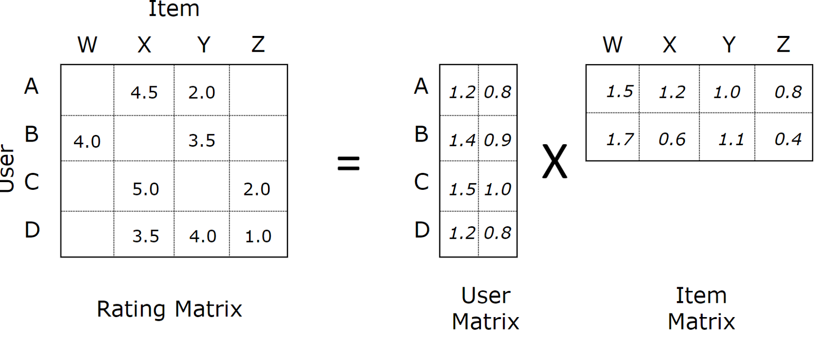


Model Based CF – Matrix Factorization
Predicted Rating-
Using Gradient Descent

Slide 14



Model Based CF – Matrix Factorization
Considering Bias -
Adding Bias to factorization -
Updated Gradient Descent -
Regularization term is Required as the Rating matrix is Sparse, which may lead to over fitting.

Slide 15
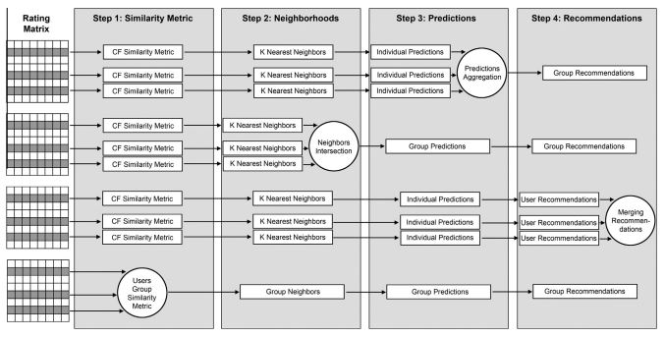
Group Recommendation

Slide 16
Demographic Filtering
Recommends Items liked by users having similar demographic info as the user.
Uses Demographic Information-
Ex – Age, Job, Location, etc.
Pros-
No feedback needed
No cold start problem
Cons-
Can’t provide Personalization
Low Accuracy
Too general

Slide 17
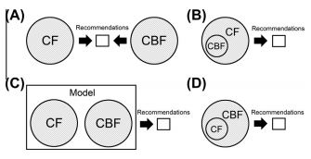
Hybrid Filtering
We try to overcome drawbacks of one using another to generate better Recommendation

Slide 18
Evaluation
Desired Properties
Accuracy
Novelty
Diversity
Stability
Reliability
Prediction Evaluation
Metric - MAE, RMSE, Coverage
Evaluation of set of recommended items
Metric – Precision, Recall, F1
Evaluation of ranked recommended items
Metric – Half life, discounted cumulative gain

Slide 19




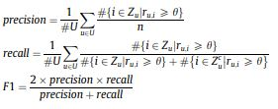



Evaluation formulas

Slide 20
Streaming RS
Details
Pros-
Change of interest is considered
Cons-
Large user base and costly infrastructure required

Slide 21
Topics to cover
TO DO-
Graph
Implicit Feedback
Data Sparsity
Cold Start Problem
Scalability
Normalization

Slide 22
Future & Challenges
Details

Slide 23
Thank You

